Slide 1
Moving Nozzle Head Update (6/5/2020)
Raghav Agarwal

Slide 2
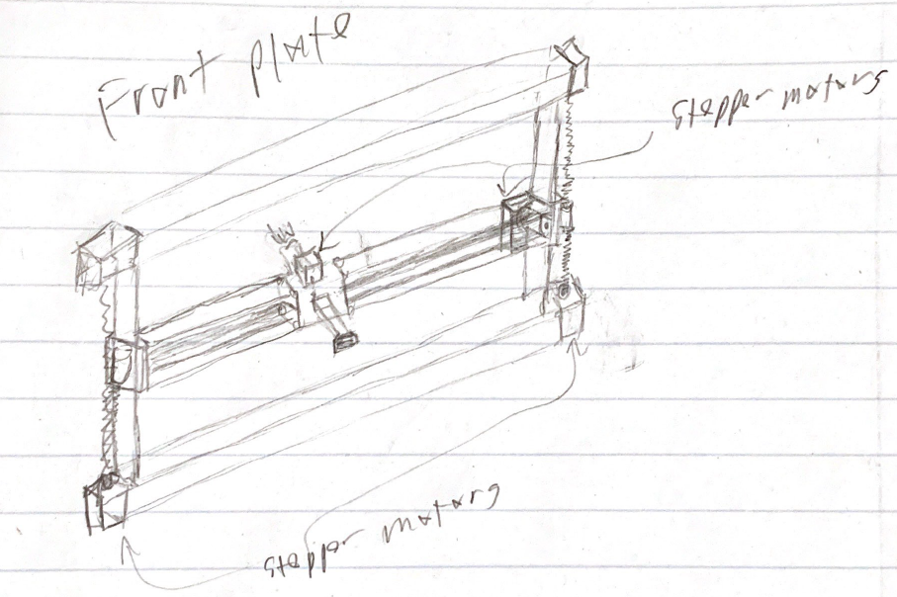
Rail System: 3D Printer Inspiration
Vertical and horizontal motion attached to front side of frame
Telescoping motion attached to nozzle carriage
Can move the cage even closer to front side of cage now that nozzle translates
Nozzle only needs to only telescope ~2.5” to cover difference in oyster cage configuration (to keep a fixed distance from the cage side as it rotates (W-H)/2)
Cage LxWxH = 28.8”x10.6”x5.51”

Slide 3
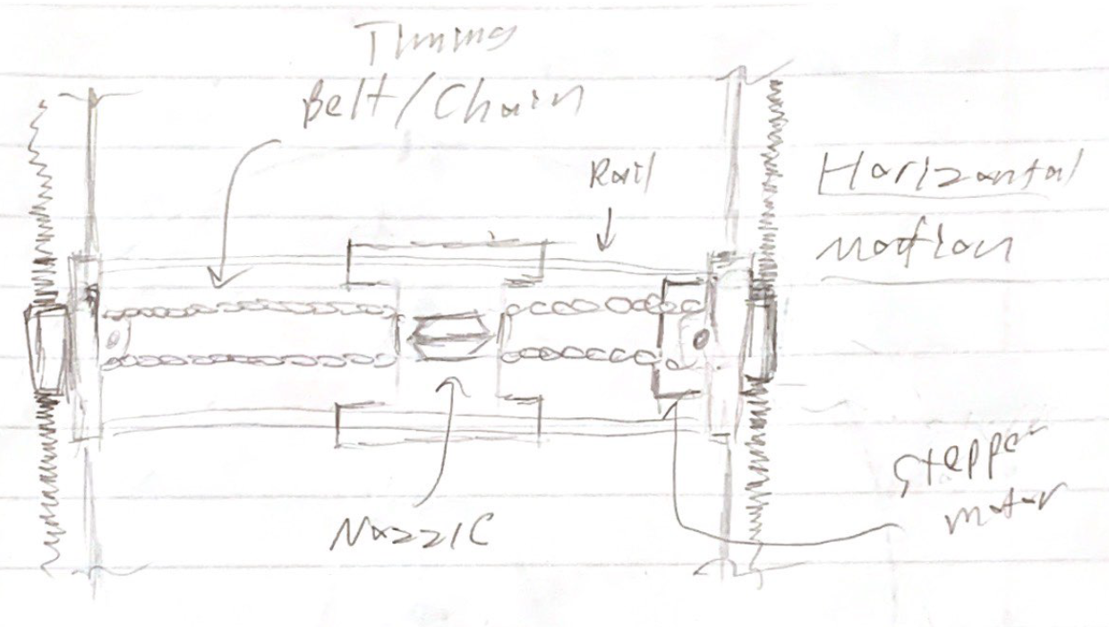
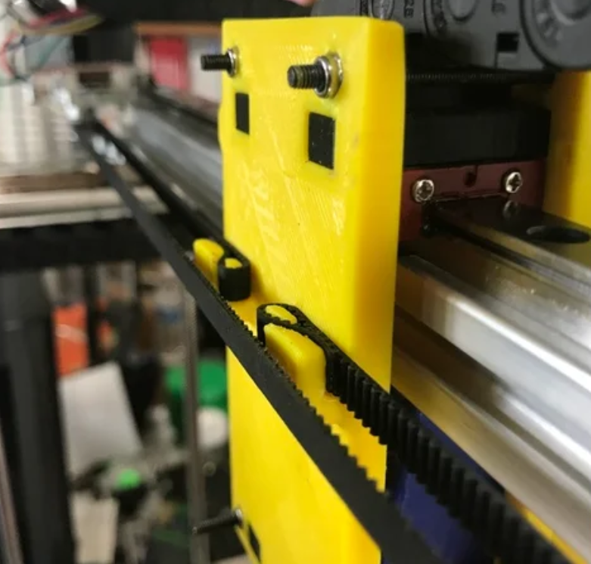
Horizontal Motion
Timing belt/chain attached to a fixed attachment on carriage with nozzle
Can use clamps or other fixtures
Stepper motor attached to one of vertical mounts to drive belt/chain
https://www.thingiverse.com/thing:2560199

Slide 4
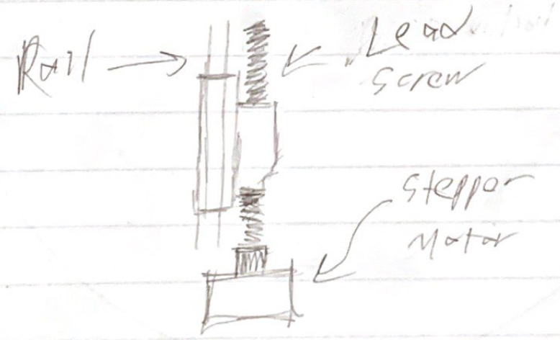
Vertical Motion
Lead screw connecting the vertical rail mount to move carriage up and down
Stepper motor attached to lead screw driving the motion

Slide 5
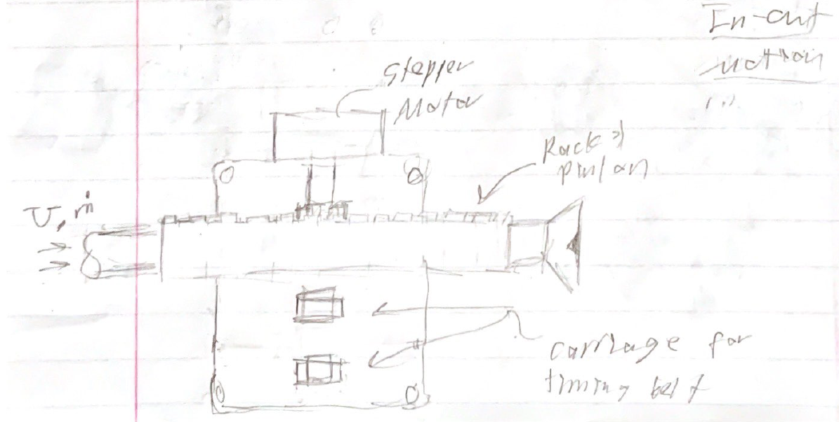
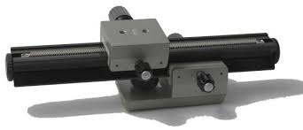
Telescoping Motion
Rack and pinion with roller supports
Ex. Microscope focusing rack
Tubing fed through square pipe rack
4 horizontal rails to provide support to carriage
http://www.savazzi.net/photography/focusing_racks.htm

Slide 6
6/4/2020 Progress

Slide 7
Overview
Create a nozzle head attachment capable of motion:
Along the length of the cage
Upwards and downwards
Inwards and outwards
These designs move the nozzle in a 2D fashion with the third dimension being an offset from the front plane of the device
Desired pitch of the jet-cage interface is assumed to be handled by rotating the rotary table of the cage indexing mechanism

Slide 8
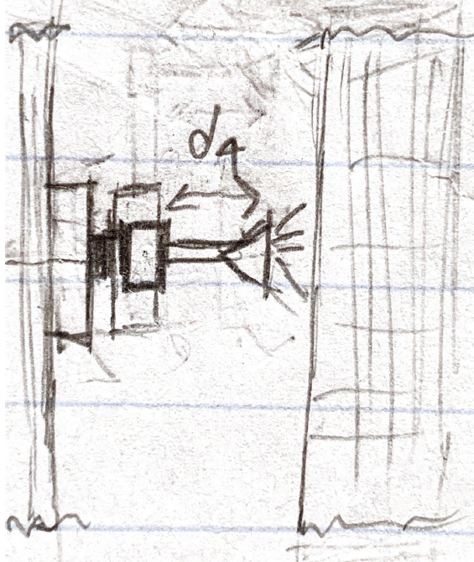
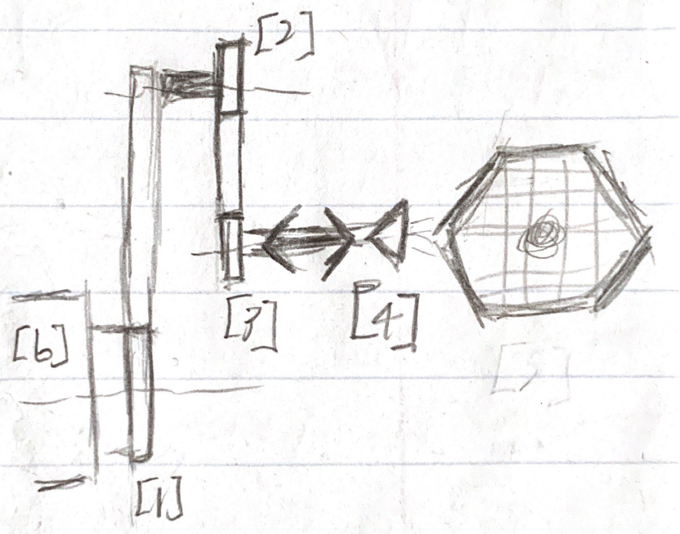
Revolute Arm
Cylindrical coordinates wrt to base frame [b]
“Simple” controls as only variable motions are 3 rotations and 1 linear translation along parallel horizontal axes (reduce number of pitches, twists, etc. to do transformations for)
Can change orientation of jet by revolving joint 3
Rotating it can make a circular projection onto a plane normal to the jet face)
Top View
Side View

Slide 9
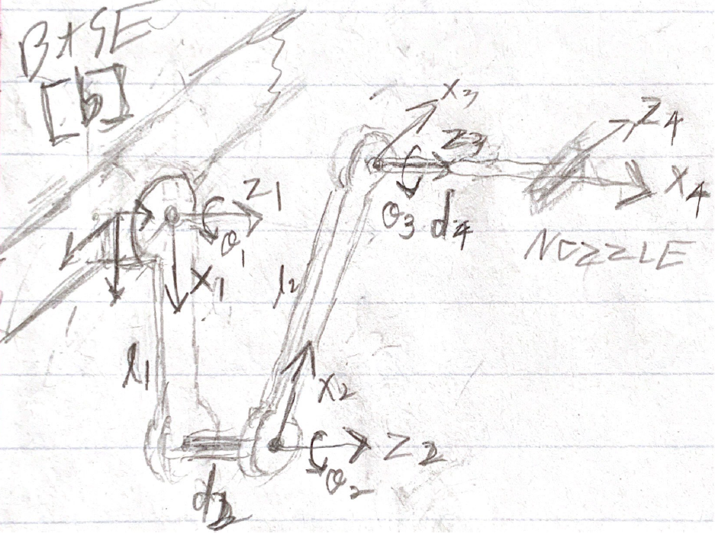
Revolute Arm: Link Parameters
Joint: i | Link Twist: αi-1 | Link Length: ai-1 | Link Offset: di | Joint Angle: θi
1 | 0 | 0 | 0 | θ1
2 | 0 | L1 | d2 | θ2
3 | 0 | L2 | 0 | θ3
4 | π/2 | 0 | d4 | 0
Base frame is coincident with joint 1 and fixed in its orientation
Joints 1, 2, and 3 are revolute
Joint 4 is prismatic and is end effector
Constrained to revolution of joint 3
d2 is fixed whereas d4 is variable (prismatic)

Slide 10
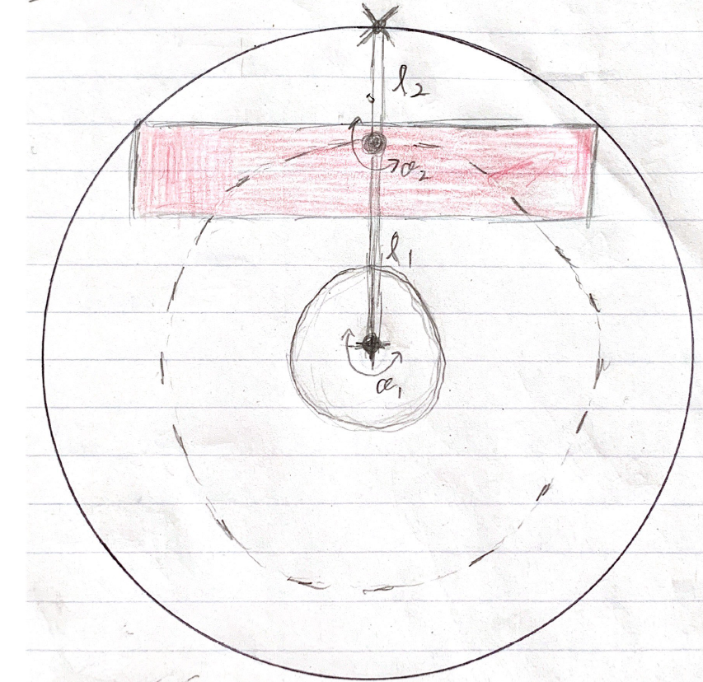
Revolute Arm: Workspace
NOZZLE
Cage sits above base frame
Green circles represent the interior and exterior boundaries of the arm’s workspace
Dashed circle represents the possible path of joint 2
Blue circle represents the possible nozzle path wrt joint 2
Nozzle should be able to cover most/all the cage without crossing below midplane of its workspace
Joint 2
CAGE
BASE
MIDPLANE

Slide 11
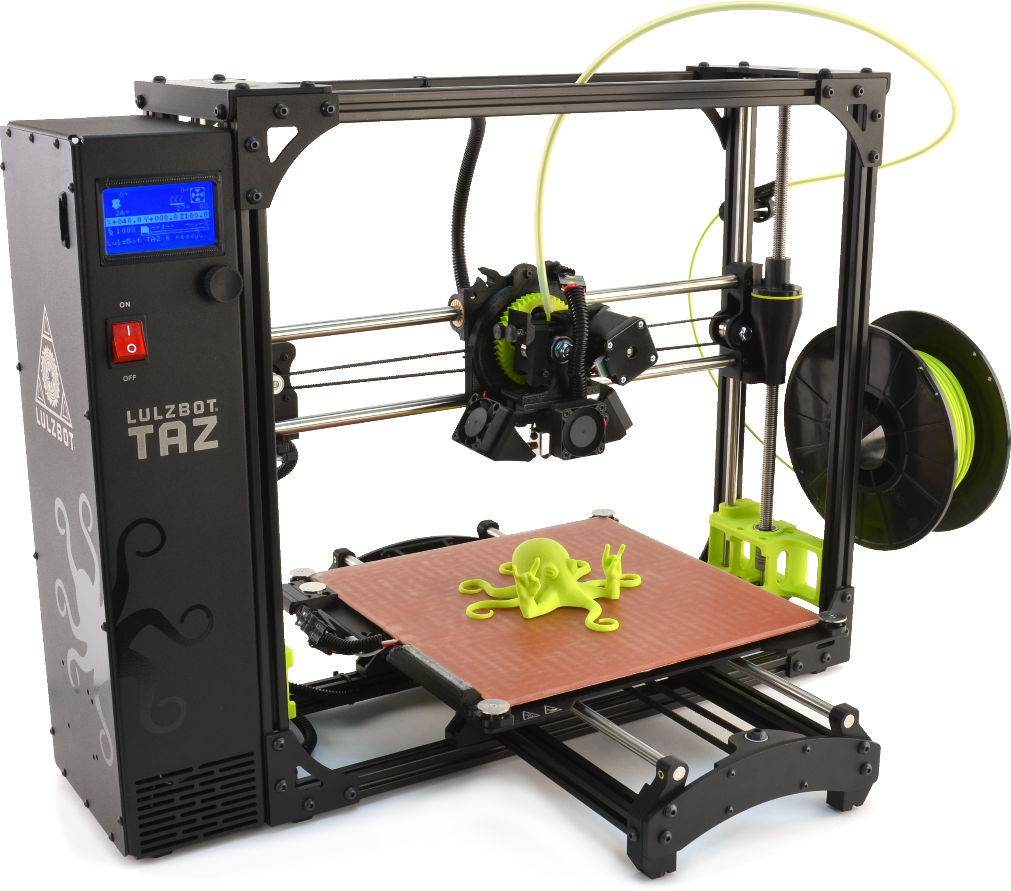
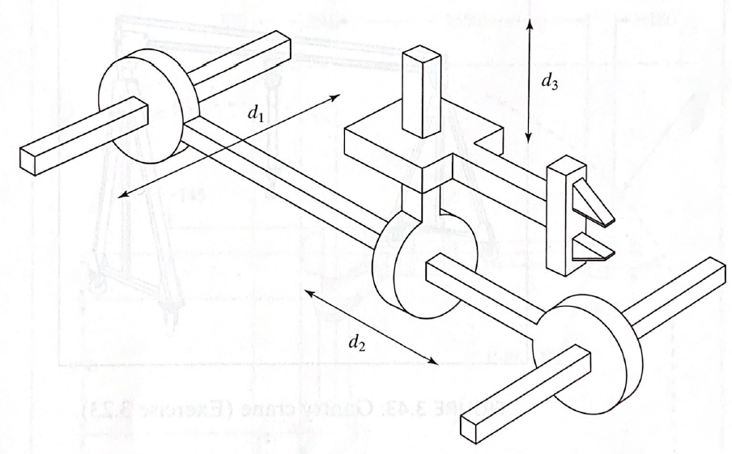
Rail System Inspiration
Cartesian coordinates wrt base frame situated at the front of the frame
Can either have vertical slides as seen in the top picture (3D printer) or horizontal slides as seen in the bottom picture (Three-link PPP manipulator)
https://www.lulzbot.com/store/printers/lulzbot-taz-6
Figure 3.1: Three-link PPP Manipulator from Introduction to Robotics: Mechanics and controls – Fourth Edition by John J Craig

